Slide 1
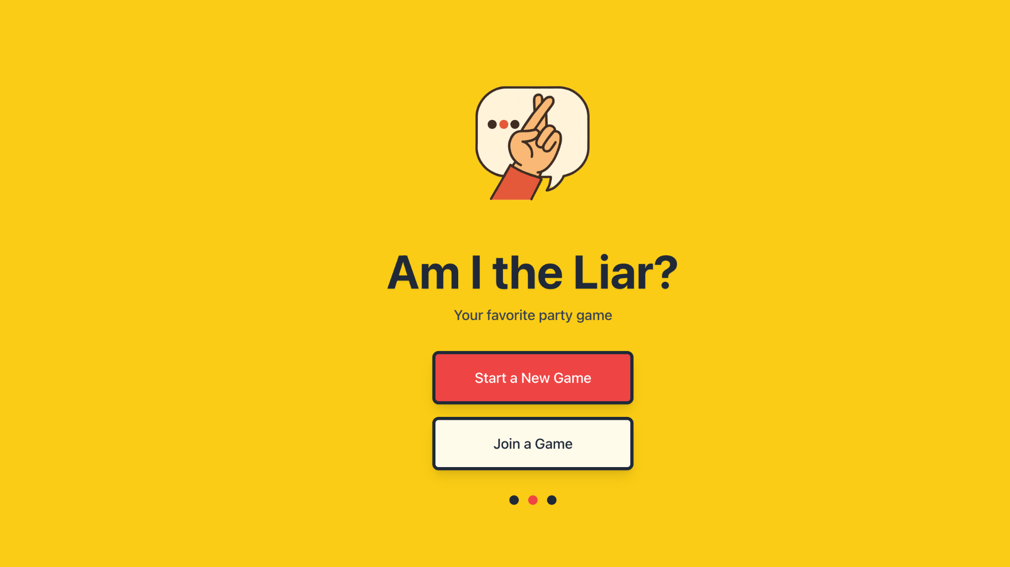
PORTFOLIO
Oct 21
Derek Kim

Slide 2


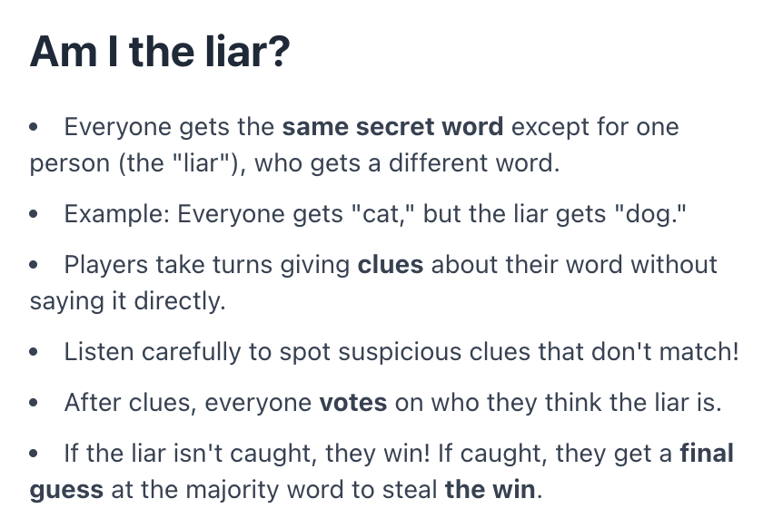
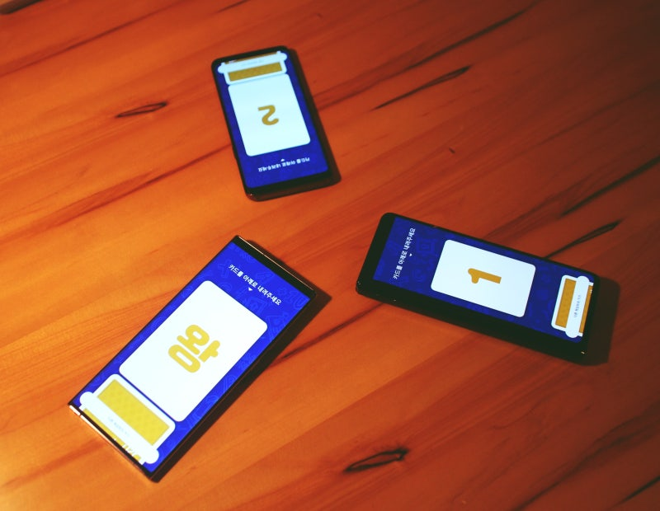
Inspiration
PORTFOLIO
Am I the Liar
#1

Slide 3




Pinterest
PORTFOLIO
Am I the Liar
#2
Pinterest

Slide 4
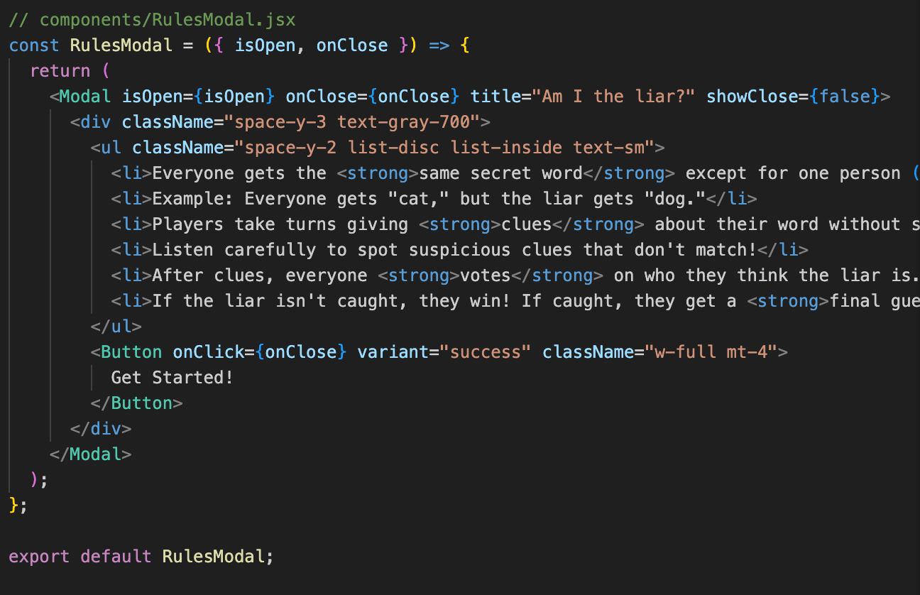
PORTFOLIO
Am I the Liar
#
React Concept Used
App.js (Main Controller)
├── HomePage.jsx (Landing Page)
├── LobbyPage.jsx (Waiting Room)
├── CategoryPage.jsx (Category Selection)
└── GamePage.jsx (Game Interface)
Shared Components:
├── Button.jsx
├── Modal.jsx
├── Input.jsx
├── NicknameModal.jsx
├── RoomCode.jsx
├── CategoryCard.jsx
├── LiarWordToggle.jsx
└── Tips.jsx

Slide 5
PORTFOLIO
Am I the Liar
#
React Concept Used
Concept | Example in My Project | Code Reference
JSX | All components use JSX syntax for UI structure | <Button variant="primary">Start Game</Button>
Componentization | Built 3 reusable components | Button, Modal, Toggle
useState | Game state management & UI controls | useState('home') for page navigation
Props | String prop, Function Prop | onClick={handleClick}>, isOpen={showNicknameModal} const HomePage = ({ onStartNewGame, onJoinGame }) => {
Event Handling | User interactions trigger state changes | onClick={() => setCurrentPage('lobby')}
CSS Framework | Tailwind CSS for responsive styling | className="bg-red-500 hover:bg-red-600"

Slide 6
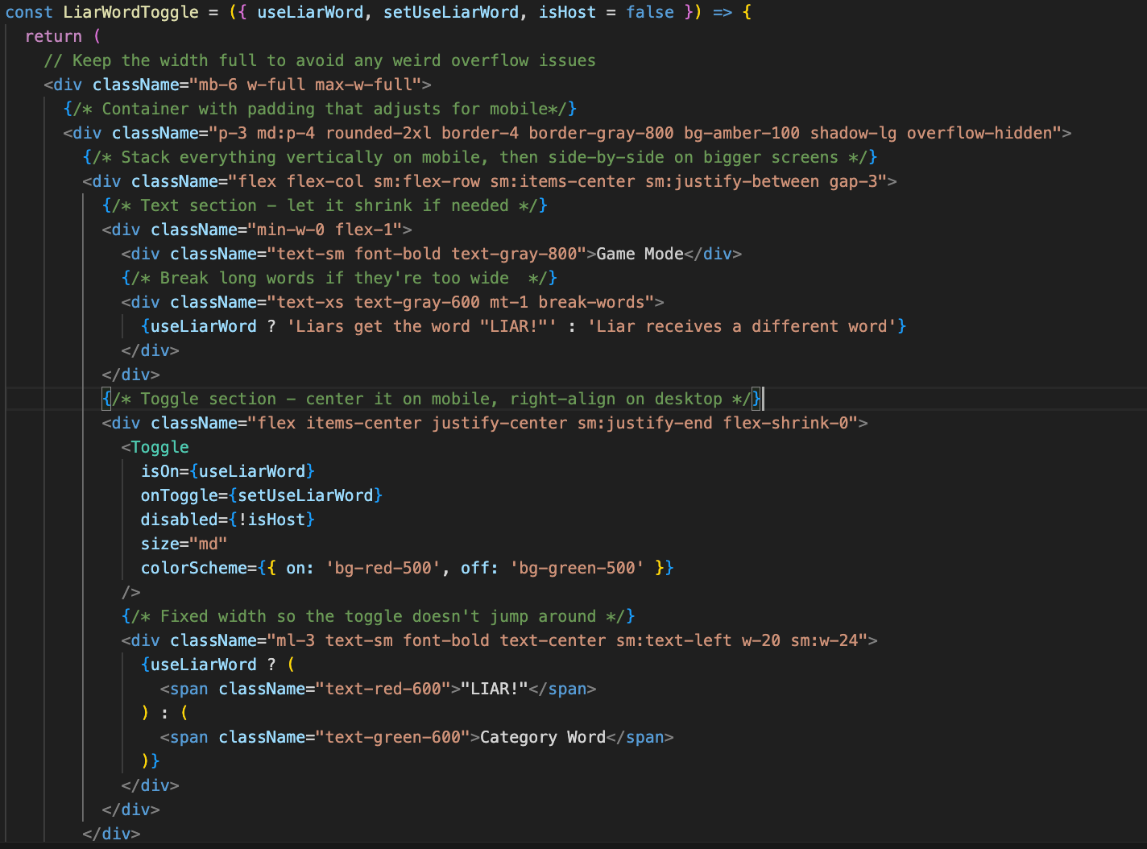
Code snippet
PORTFOLIO
Am I the Liar
#

Slide 7


Next Step
PORTFOLIO
Am I the Liar
#
Incorporate supabase to add in backend support
Use Vercel to launch my website

Slide 8
Thank You
Am I the Liar

